Slide 1

E-Technician
A software for revolutionising how clients reach service providers.
GROUP-26

Slide 2
Project description
E-Technician
We are developing a user-friendly platform that connects clients with local technicians. Clients can easily submit descriptions, photos, or videos of their service needs. Technicians in the area will review these requests and provide solutions with estimates. The platform aims to simplify the decision-making process for clients, allowing them to choose the best technician quickly and confidently.

Slide 3
Objectives of the project
E-Technician
The main objectives of our project is:
To revolutionise the process of accessing skilled technicians swiftly and effortlessly.
To develop User-Friendly Platform for both clients and service providers.
To reduce the amount of time it takes for clients to find the right service provider.
To implement Matching Algorithm for clients and service providers.
To secure integration of Communication and Payment Tools.

Slide 4
Targeted audience
E-Technician
The targeted audience for the E-Technician platform includes:
Individual Consumers.
Small Businesses.
Property Managers.
Service Providers.

Slide 5
Software Process Modeling

Slide 6
Stakeholders
E-Technician
Client
Technician
Application Development & Maintenance Team
Payment Service Providers
Location Prompt Participants

Slide 7
System specification
E-Technician
Login systems.
Profile management systems.
Media systems.
Location systems.
Chatting systems.
Payment systems.
Rate and review systems.

Slide 8
Functional requirements:
E-Technician
Individuals can register by providing basic information such as name, contact details, and location.
Technicians register as service providers and must submit proof of their skill qualifications/experience.
Technicians can showcase their past work, customer testimonials, and ratings within their profiles.
Clients can describe their issue, upload images or videos, and submit this information to the platform.
All registered engineers within the client’s area automatically receive the submitted problems.
Technicians provide an estimated cost and timeframe* for solving the problem based on the client’s description and multimedia content.
Clients can review all estimates and select the technician based on the best offer.
Clients can rate and review technicians after service completion.

Slide 9
Non-functional requirements:
E-Technician
The system should handle a large number of registered users and submitted problems.
The platform ensures data privacy and security for all clients.
Secure online payment and digital invoicing are available.
A secure messaging system allows clients and engineers to discuss details effectively.
The platform must be available and responsive when clients and technicians interact.
Platform improvements should be possible without disrupting existing functionality.

Slide 10
Used technologies
E-Technician
Programming Languages and Frameworks:
  Frontend Development: Flutter
  Backend Development: Node.js with Express.js
  Database Management:
  MySQL
Payment Integrations:
  Bank APIs
Security & Authentication:
  HTTPS, SSL/TLS security protocols.
Testing Tools:
  Jest, Detox.

Slide 11

E-Technician
Sample User Story 1
Task: Find a key changer.
Simulation: Ali is a homeowner living in Ankara. He forgot his home keys inside,
and he wanted his door key to be changed.
Actions:
Ali visits the E-technician app and registers as client hiring service providers.
He will choose “publish an offer”.
Then he will choose that he is looking for a key changer,in Kecioren, Ankara.
He will put a photo/video of the door key.
Under the graphic he will write a description about the problem.
Lastly he will fill the time he needs the provider and the budget he is planned for.
He will publish and wait till he gets detailed requests form the service providers.
Result:
Ali will choose one of the requests he got and he can chat him privately if he want to talk with the service provider any extra info, rather than that he will accept the voicemail that the technician sent to him and he will pay, Ali will approved when the technician gots the work done and by that ali got his door key changed with finger taps.

Slide 12

E-Technician
Sample User Story 2
Task: Find a client to provide a service.
Simulation: Ahmet is a door key changer, works in Kecioren, Ankara.
Actions:
Ahmet will visits the E-technician app and registers as Technicians.
He will fill his registration.
Then when an offer of key changing contract publishes in his area he will get notification.
He will check the offers and when he finds a suitable one for him he will send request of how much he will work for and how long it will take him to finish .
When he gets approve from the client he will send a voicemail of their contract.
He will get paid after the client approves the finish of the work.
Result:
Ali successfully found client and settled an contract easy and fast, for the end of the day he got paid.

Slide 13
Software Development Methodology
E-Technician
Our project embraces Agile methodology to facilitate rapid and effective development within a limited timeframe. We prioritize iterative development and continuous feedback, enabling us to quickly prototype and engage with users throughout the development process. By adopting Agile principles, we ensure flexibility, responsiveness, and collaboration, allowing us to deliver value to our stakeholders efficiently.

Slide 14
System Modeling

Slide 15
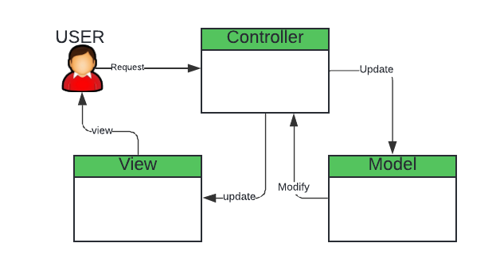
Application Architecture(MVC)
E-Technician
View Layer: This layer represents the user interface where users interact with the application. Users submit service requests through the view layer.
Controller Layer: The controller layer receives requests from the view layer, processes them, and sends them to the appropriate model for further action.
Model Layer: The model layer handles data storage and retrieval. It updates the data based on user requests and interacts with the database.

Slide 16
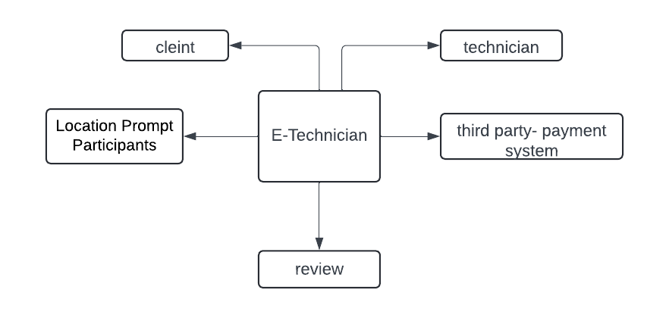
Context diagram
E-Technician

Slide 17
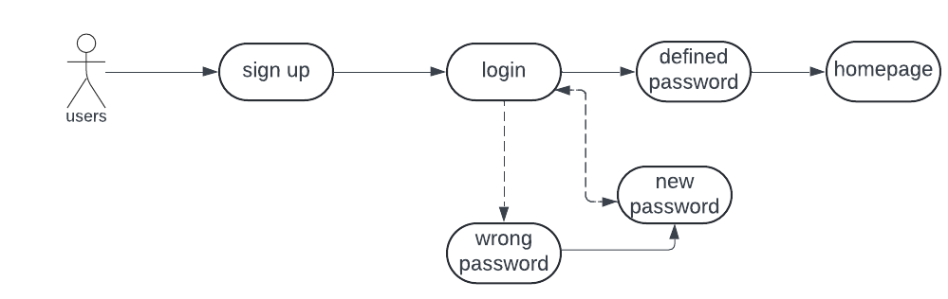
Use-case diagram
E-Technician

Slide 18
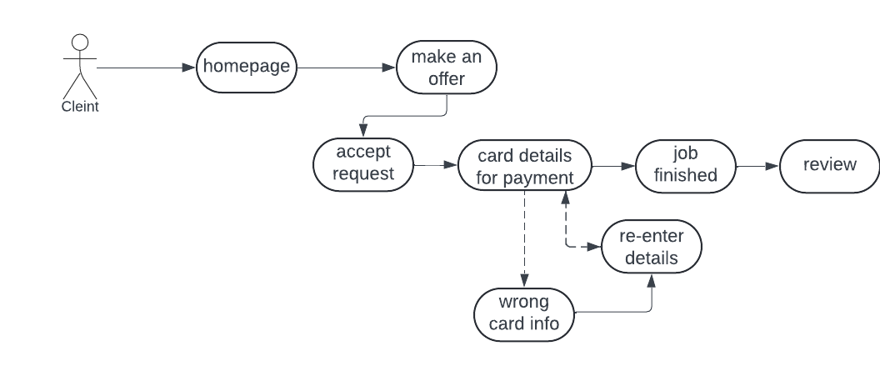
Client use-case diagram
E-Technician

Slide 19
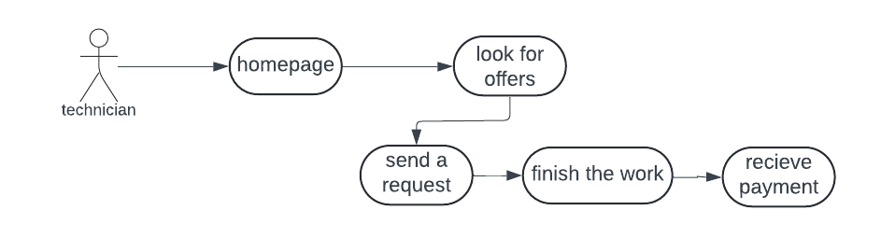
Technician use-case diagram
E-Technician

Slide 20
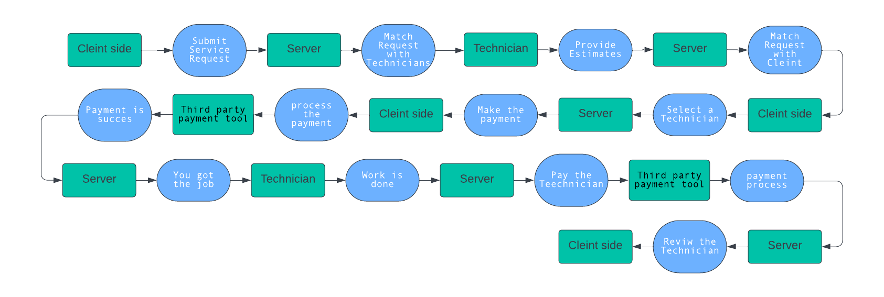
Data driven modeling

Slide 21
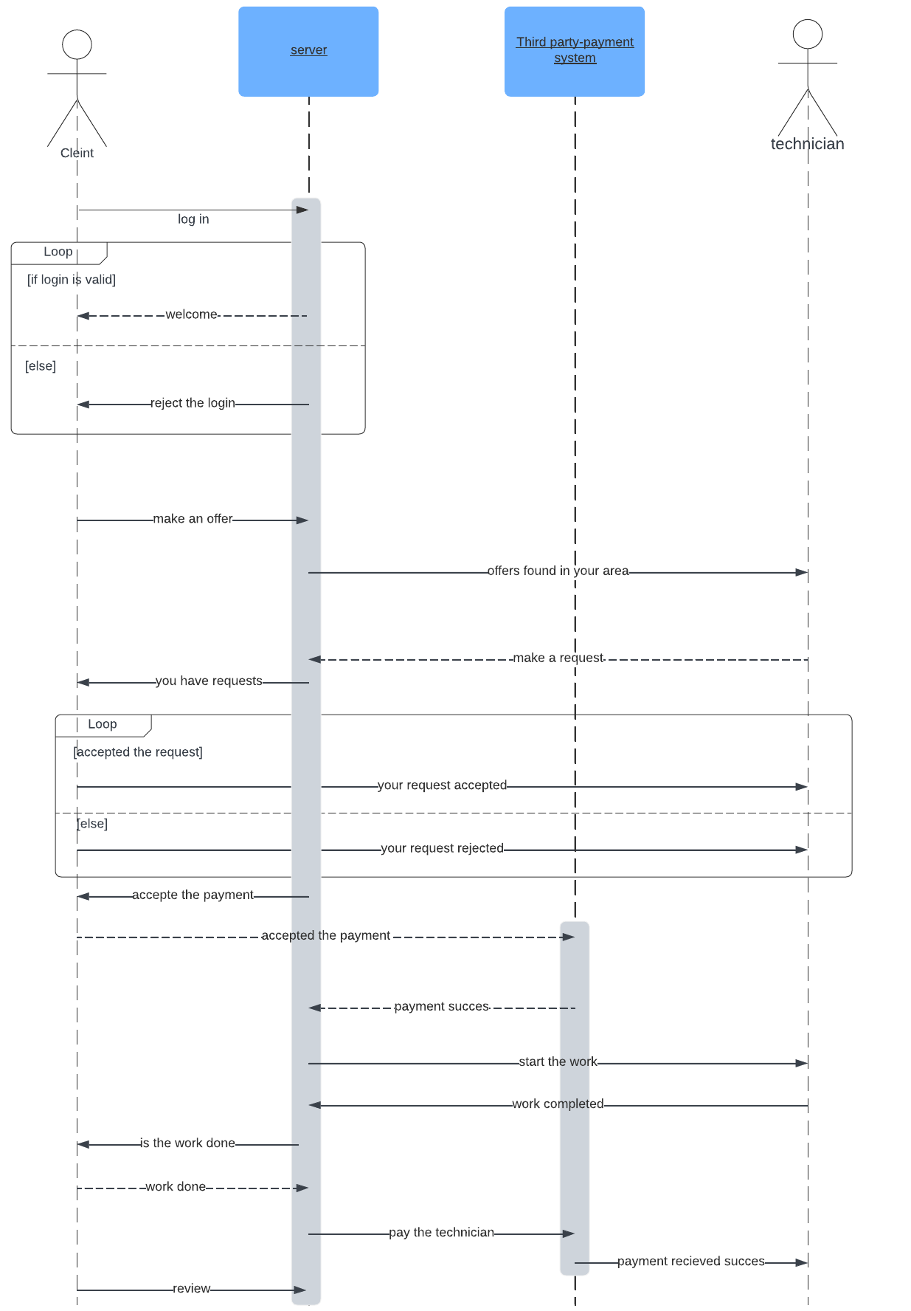
Sequence diagram
E-Technician

Slide 22
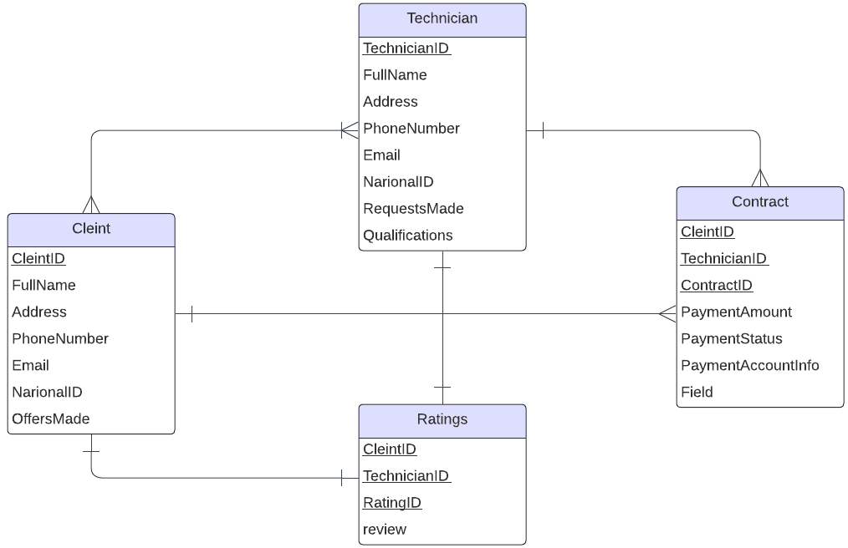
Database design
E-Technician

Slide 23
Thanks
Any question?

